Slide 1
Stress, Conflict &Anger Management

Slide 2
STRESS
“A physical or psychological stimulus that can produce mental tension or physiological reactions that may lead to illness.“
In a medical or biological context stress is a physical, mental, or emotional factor that causes bodily or mental tension

Slide 3


Slide 4
TYPES OF STRESS
Eustress
Distress
Hyper stress
Hypo stress

Slide 5
Eustress
Eustress is a type of short-term stress that provides immediate strength. Eustress arises at points of increased physical activity, enthusiasm, and creativity. Eustress is a positive stress that arises when motivation and inspiration are needed. A gymnast experiences eustress before a competition.

Slide 6



Eustress
    It is the stress that is healthy or
    gives one a feeling of fulfillment.
      Acing your exams
      Getting a promotion
      Vacations
Notes:
mohsin

Slide 7
Distress
Distress is a negative stress brought about by constant readjustments or alterations in a routine. Distress creates feelings of discomfort and unfamiliarity. There are two types of distress. Acute stress is an intense stress that arrives and disappears quickly. Chronic stress is a prolonged stress that exists for weeks, months, or even years. Someone who is constantly relocating or changing jobs may experience distress.

Slide 8
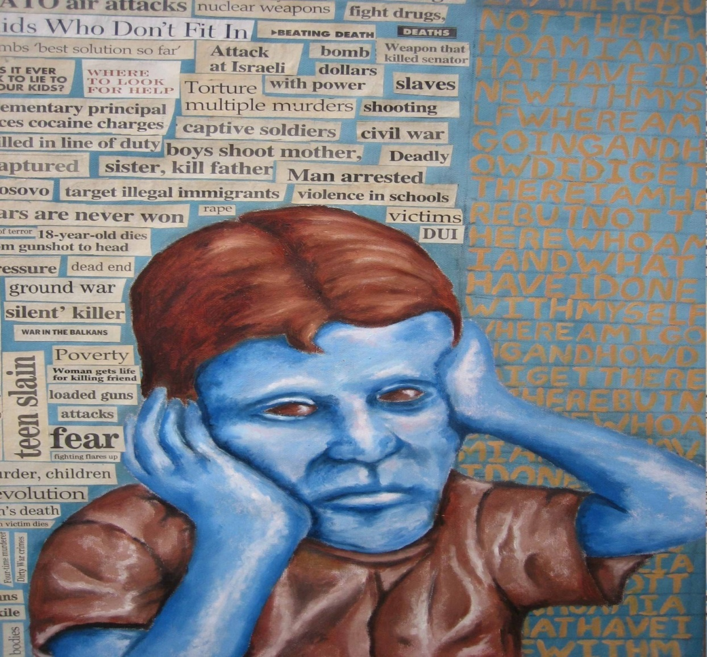

Slide 9
Hyperstress
Hyperstress occurs when an individual is pushed beyond what he or she can handle. Hyperstress results from being overloaded or overworked. When someone is hyperstressed, even little things can trigger a strong emotional response. A Wall Street trader is likely to experience hyperstress.

Slide 10


Slide 11
Hypostress
Hypostress is the opposite of hyperstress. Hypostress occurs when an individual is bored or unchallenged. People who experience hypostress are often restless and uninspired. A factory worker who performs repetitive tasks might experience hypostress.

Slide 12
Causes of stress
  Death of spouse, family, near relative or friend.
  Injury or illness of any family member.
  Separation or divorce from partner.
  Not sufficient money to raise your standard of living etc
  Threats: physical threats, social threats, financial threat, other threats.
  Uncertainty.
  Lack of sleep.
  Somebody misunderstands you.
  Setback to your position in society.

Slide 13
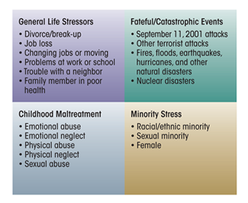
Causes

Slide 14
Symptoms of Stress
Indesciveness
Memory problems
Inability to concentrate
Trouble thinking clearly
Poor judgment
seeing only the negative
Headaches or backaches
Muscle tension and stiffness
Diarrhea or constipation
Nausea, dizziness
Chest pain, rapid heartbeat
Weight gain or loss
Skin breakouts (hives, eczema)
Loss of sex drive
Frequent colds

Slide 15
Moodiness
Agitation
Restlessness
short temper
Irritability , impatience
Inability to relax
Feeling tense and “on edge”
Feeling overwhelmed
Sense of loneliness and isolation
Depression or general unhappiness
Eating more or less
Sleeping too much or to little
Isolating yourself from others
Procrastination , neglecting responsibilities
Using alcohol, cigarettes, or drugs to relax
Nervous habits
Teeth grinding
Overdoing activities
overreacting to unexpected problems

Slide 16
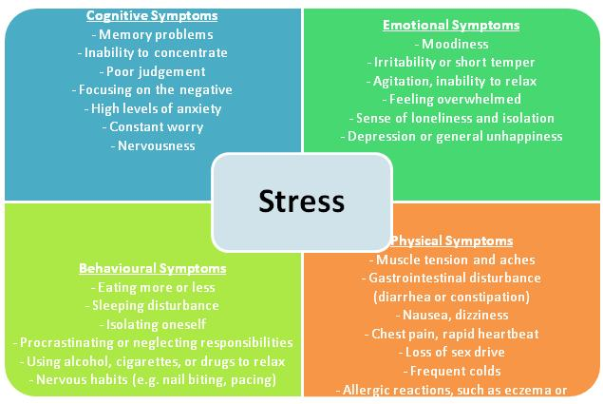
Symptoms

Slide 17
Effects of stress
Migraines
Ulcers
Heartburn
High blood pressure
Heart disease
Diabetes
Asthma
Skin problems
Chronic head ache
Mood swings
Substance abuse
Memory disturbances
Heart attack due to increased blood pressure, sugar and cholesterol
Stroke due to similar reasons
Weight loss
Anxiety
Depression
Eating disorders
Substance abuse.
Chest pain
Cold clammy skin with gooseflesh
Flushing and feeling of warmth
Breathlessness
Dry mouth with difficulty in speaking and swallowing
Abdominal discomfort
Aggravation of Peptic Ulcer

Slide 18
How to cope with stress?
Coping refer to the specific efforts, both behavioral and psychological, that people employ to master, tolerate, reduce, or minimize stressful events.
    Two Strategies for coping
        Emotion-focused coping strategies
        Problem-solving strategies
Notes:
mohsin

Slide 19
Emotion-focused coping strategies
Emotion focused strategies involve releasing pent-up emotions, distracting one-self, managing hostile feelings, meditating, using systematic relaxation procedures, etc
Strategies aimed at changing the way one thinks or feels about a stressful situation.
Notes:
zain

Slide 20

Relaxation Techniques
Autogenic relaxation:
  Autogenic means something that comes from within you.
Progressive muscle relaxation:
  In this technique, you focus on slowly tensing and then relaxing each muscle group. This helps you focus on the difference between muscle tension and relaxation
Other Techniques include
  Yoga
  Tai chi
  Music
  Exercise
  Meditation
  Hypnosis
Notes:
Zain

Slide 21
Unhealthy ways of coping with stress
Smoking
Drinking too much
Overeating or undereating
Zoning out for hours in front of the TV or computer
Withdrawing from friends, family, and activities
Using pills or drugs to relax
Sleeping too much
Procrastinating
Filling up every minute of the day to avoid facing problems
Taking out your stress on others (lashing out, angry outbursts, physical violence)

Slide 22
Healthy ways of coping Stress
Learn how to say “no”
Avoid people who stress you out
Take control of your environment
Avoid hot-button topics
Pare down your to-do list
Express your feelings instead of bottling them up.
Be willing to compromise.
Be more assertive.
Manage your time better.
Reframe problems. Look at the big picture.
Adjust your standards.

Slide 23
Set aside relaxation time.
Connect with others.
Do something you enjoy every day.
Keep your sense of humor.
Exercise regularly.
Eat a healthy diet.
Reduce caffeine and sugar.
Avoid alcohol, cigarettes, and drugs.
Get enough sleep.
Focus on the positive.
Don’t try to control the uncontrollable.
Look for the upside.
Share your feelings.
Learn to forgive.

Slide 24
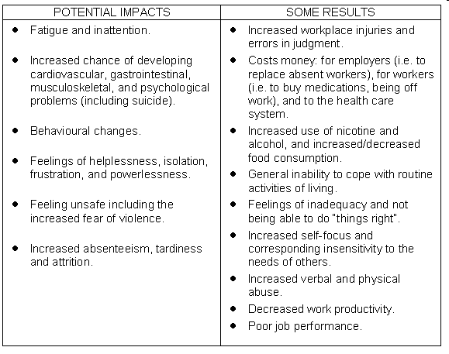

Slide 25
Conclusion
Stress is always present in one form or another. Its up to an individual how he/she copes and alleviates stress.
Coping strategies are not always going to solve stress they are dynamic; every individual has different strategies to deal with stress.
Notes:
Mansoor

Slide 26
STRESS QUESTIONAIRE
Answer Yes or No to each of the following questions:
1. Do you have a feeling of continuous anxiety and sometimes of panic?
2. Do you feel tired all the time and find that you complain more and more of not
getting enough sleep?
3. Are you always worrying about your health? Do you feel your work is suffering?
4. Do you often feel depressed for no good reason?
5. Are you tense and restless and unable to relax?
6. Do you get sudden tremors – “the shakes”?
7. Are you afraid of being alone?
8. Do you ever want to end it all?
9. Do you sometimes wonder if you are losing your mind?
10. Do you take other people’s criticisms as personal threats or rejections?

Slide 27
11. Do you lose your temper more often and find it harder to get along with others?
12. Do you find it hard to concentrate these days?
13. Do you feel remote from people who were close to you and things you love like
friends, sports, books?
14. Have you started to let your appearance run down – are you careless about your
clothes?
15. Are you worrying a great deal, taking life more seriously, enjoying it less?
16. Are you dependent on tranquilizers to carry you through the day?
17. Is it becoming harder for you to make small decisions, such as what to have for
dinner, what to do next?
18. Do you dread ordinary everyday situations caring for your children or even going to the store?
19. Has your attitude toward food changed do you find it tasteless, hard to care if you eat or not?
20. Do you find yourself living more and more in the past?

Slide 28
Conflict and Frustration
Conflict:
‘A psychic struggle, often unconscious, resulting from the opposition or simultaneous functioning of mutually exclusive impulses, desires, or tendencies.’
Frustration:
‘Frustration is an emotional response to circumstances where one is obstructed from arriving at a personal goal.’ It can be caused by internal and external factors.

Slide 29
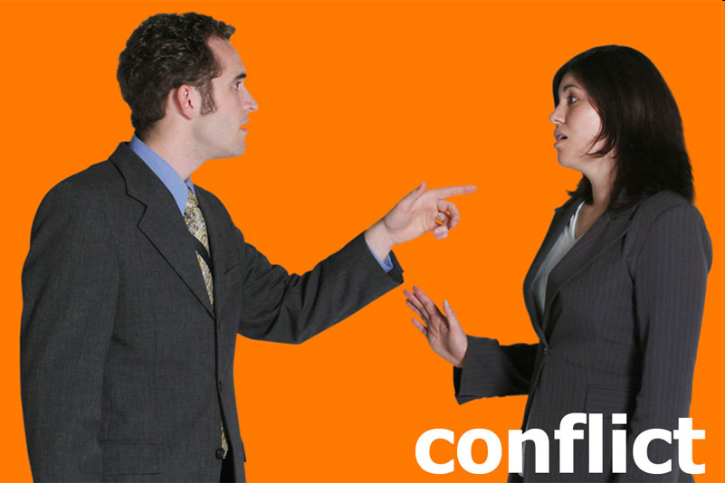

Conflict
Frustration

Slide 30
Types of Conflicts
Avoidance-avoidance conflict:
“A situation in which an individual is confronted by two unattractive alternatives.”
Ex: The child who is faced with "Either you do your homework or you go to bed without supper." Both the things are not attractive for him but he has to choose one.

Slide 31
Approach-Approach conflict:
“Psychological conflict resulting from the necessity of choosing between two desirable alternatives.”
Ex: A person, who has limited money, wants to get marry but at the same time he wants to buy a house. He has to choose one thing between the two.

Slide 32
Approach-avoidance conflict:
“Psychological conflict that results when a goal has both desirable and undesirable aspects.”
Ex: The timid man who wishes to propose to his girl friend fears rejection (the quality he wishes to avoid) and hopes for acceptance (the quality he wishes to approach). Hence he is in conflict about a single goal.

Slide 33
DOUBLE APPROACH-AVOIDANCE
“In real life, the individual frequently is faced with having to choose between two (or more) goals, each of which has both attracting and repelling aspects. Since the tendency is to approach and avoid each of the goals, this pattern is called double approach-avoidance.”
Ex: Choosing a house in the country means fresh air, room to live, peace and quiet. It also means many hours of commuting to work in heavy traffic and long distances from city amenities and cultural events. Choosing to live in the city will likewise present both the problems and the advantages of city life.

Slide 34
ANGER & ANGER MANAGEMNT

Slide 35
Define
Anger is defined as feeling of annoyance, displeasure or antagonism.
Anger is an intense emotion which involves hostile response to threat.

Slide 36
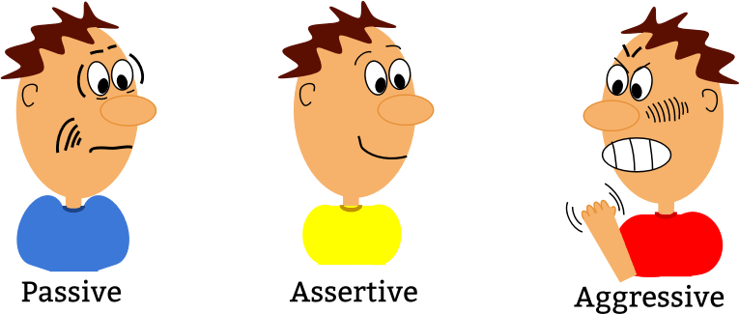
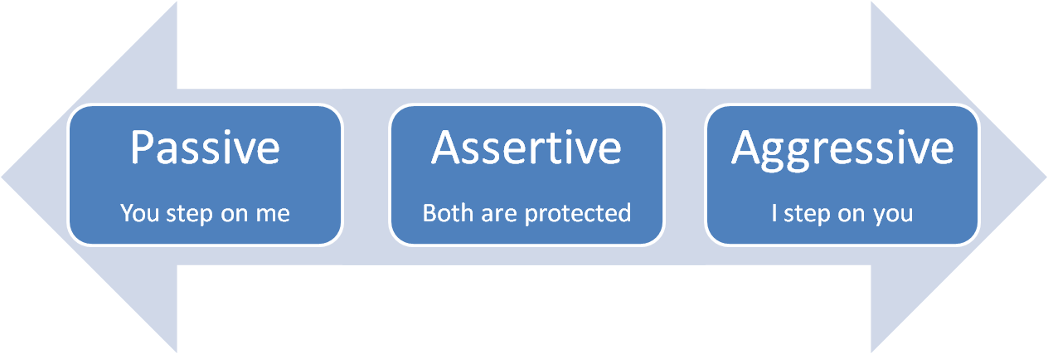
Types
Aggressive
Assertive
Passive

Slide 37
Types of Anger
Passive:They avoid dealing with situation that make them angry.
Aggressive:Express outwardly they yell and bully others.
Assertive:They work through the emotion and try resolve.

Slide 38
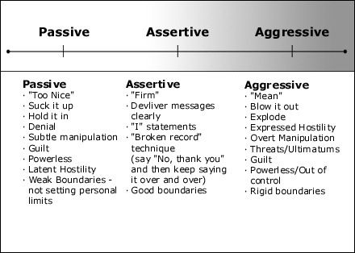
Anger types

Slide 39
ANGER MANAGEMENT
Know the difference between anger and aggression.
Anger is an emotion. It is ok to be angry.
Aggression is acting out inappropriately and is not ok. Learn to check your aggression and express your anger appropriately.

Slide 40
Causes
Symptoms
personal problems, such as missing a promotion at work or relationship difficulties
a problem caused by another person such as cancelling plans
an event like bad traffic or getting in a car accident
memories of a traumatic or enraging event
anger that affects your relationships and social life
feeling that you have to hide or hold in your anger
constant negative thinking and focusing on negative experiences
constantly feeling impatient, irritated, and hostile
arguing with others often, and getting angrier in the process

Slide 41
Symptoms
being physically violent when you’re angry
threatening violence to people or their property
an inability to control your anger
feeling compelled to do, or doing, violent or impulsive things because you feel angry, such as driving recklessly or destroying things
staying away from certain situations because you’re anxious or depressed about your angry outbursts

Slide 42
ANGER MANAGEMENT
Identify internal cues to feelings of anger:
Stomach gets tight/upset
Heart is beating faster
Clenching fists
Feel myself getting flushed
Pressure on my temples
Sweaty palms
Clenched jaw

Slide 43
ANGER MANAGEMENT
Identify a range of feelings including anger:
Embarrassment
Excitement
Disappointment
Jealousy
Fear
Helpless
Sadness
Left-out

Slide 44
ANGER MANAGEMENT
Identify aggressive acts shown by self and others:
Throw something
Kick someone or something
Get in someone’s face
Shoving, grabbing, hitting
Break something
Call someone names
Give someone a dirty look
Silent treatment
Get others to “gang up”
Spread rumors

Slide 45
Coping strategies
Relaxation techniques
Cognitive restructuring
Problem solving
The balloon technique
Exercise

Slide 46
ANGER MANAGEMENT
Skills needed in dealing with your anger:
Identify a range of feelings including anger
Identify aggressive acts by self and others
Identify the potential consequences to self and other from these aggressive acts
Identify self-destructive behavior
Identify thoughts prior to aggressive acts
Identify internal cues to feelings of anger
Develop coping mechanisms for dealing with anger
Express anger without loss of control

Slide 47
ANGER MANAGEMENT
Ways to Keep Cool:
Get exercise every day.
Eat right.
Get enough sleep.
Learn to relax.
Know your feelings.
Write about those feelings.

